Slide 1

Basics of Python & Introduction to Artificial Intelligence
Subtitle: From Installation to Basic Programming and an Overview of AI
Presented by : Dr. Inam Ullah Khan

Slide 2
Outline
1 | Basics of Python Installation Basic Programs
2 | Introduction to Artificial Intelligence Brief History of AI AI Terminology
3 | Anaconda Installation Setting up the Environment Introducing Jupyter Notebook
4 | Introduction to Python Installing Python on Windows Writing Your Name using print() Running Python Operators Basic Mathematical Functions in Python

Slide 3

Installing Anaconda
step 1: Download Anaconda from https://www.anaconda.com/download/success.

Slide 4

Installing Anaconda
Step 2: it will start to downloading

Slide 5
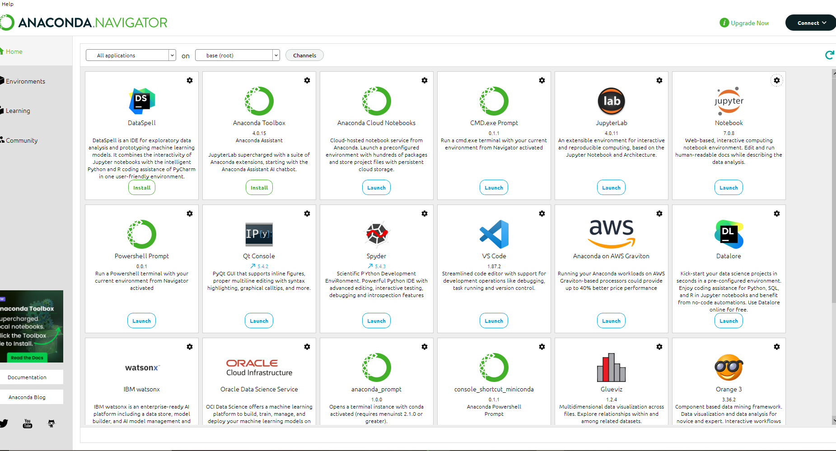
Installing Anaconda
Step 3: after downloading , open anaconda navigator something like this screen will appear

Slide 6
Installing Anaconda
Step 4: now see on right of the first row , you'll see Jupyter , click launch below jupyter to launch it

Slide 7
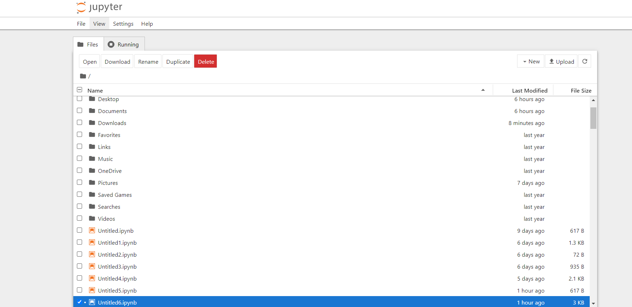
Installing Anaconda
Step 5: after launching it will open jupyter notebook

Slide 8
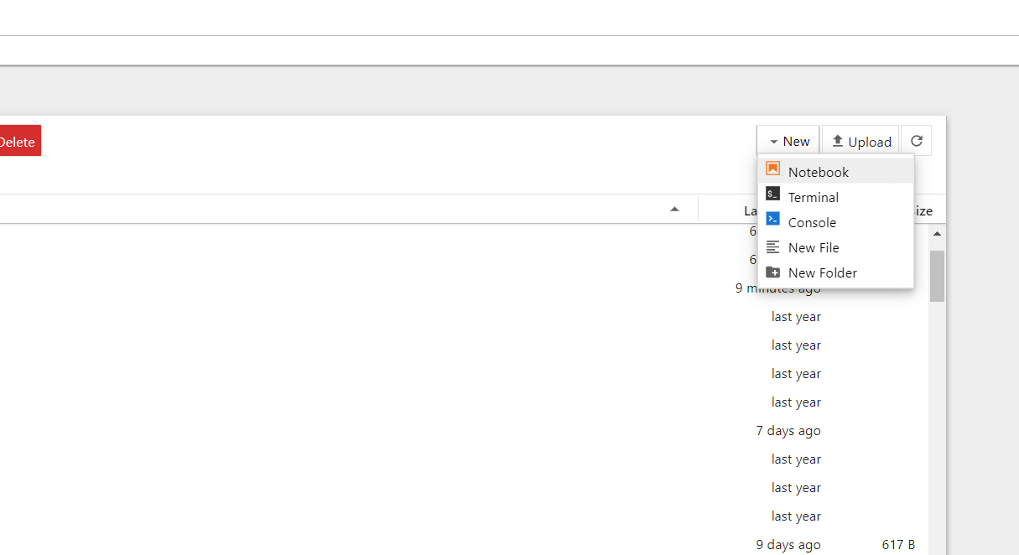
Installing Anaconda
Step 6:nowgo to new on the right and afterwards select new notebook

Slide 9
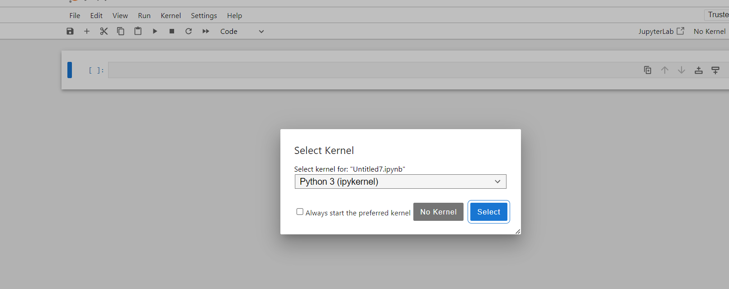
Installing Anaconda
Step 7:after opening it, select python3 and you're jupyter notebook is ready to write a code

Slide 10
Introducing Jupyter Notebook
Overview:
Jupyter Notebook is an open-source web application
that allows you to create and share documents containing live code,
equations, visualizations, and narrative text.
Launching Jupyter Notebook:
Use Anaconda Navigator or run jupyter notebook in the command line.

Slide 11
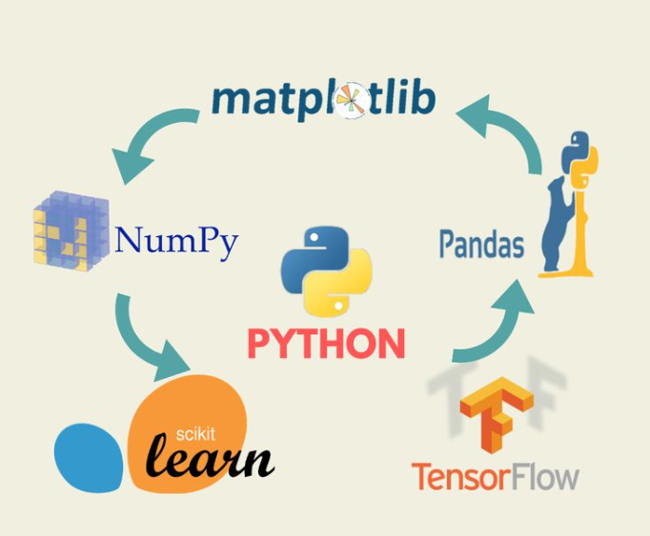
Basic python libraries with brief explanation
NumPy
Purpose: NumPy is fundamental for numerical computing in Python.
It provides support for large,
multi-dimensional arrays and matrices, along with a collection of
mathematical functions to operate on these arrays efficiently.
Example: Used for array manipulation, mathematical operations,
linear algebra, and random number generation.
Pandas
Purpose: Pandas is used for data manipulation and analysis.
It offers data structures like
DataFrames (tabular data) and Series (labeled arrays), along with tools
for reading and writing data between different formats (CSV, Excel, SQL databases).
Example: Used for data cleaning, transformation, filtering, and aggregation tasks in data science and analytics.

Slide 12
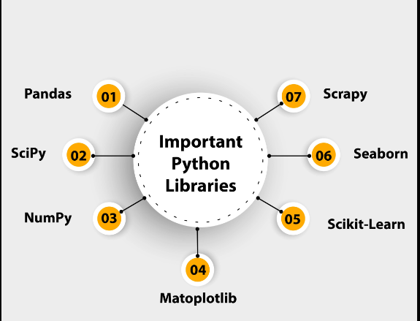
Basic python libraries with brief explanation
Matplotlib
Purpose: Matplotlib is a plotting library for creating static, animated, and interactive
visualizations in Python. It provides a MATLAB-like interface for creating plots,
histograms, scatter plots, etc., with publication-quality output.
Example: Used for visualizing data trends, distributions, correlations, and patterns in graphical form.
Scikit-learn
Purpose: Scikit-learn is a machine learning library that provides simple and efficient tools for data mining and data analysis. It features various algorithms for classification, regression, clustering, dimensionality reduction, and model selection.
Example: Used for building machine learning models, evaluating model performance, and preprocessing
data before feeding it into models.

Slide 13
Basic python libraries with brief explanation
TensorFlow
Purpose: TensorFlow is an open-source machine learning framework developed by Google for building
and training machine learning models. It provides tools for deep learning, including neural networks,
and supports deployment across a variety of platforms (CPU, GPU, TPU).
Example: Used for developing and training deep learning models for tasks like image classification,
natural language processing, and reinforcement learning.
Keras
Purpose: Keras is a high-level neural networks API, written in Python and capable of running on top of TensorFlow,
Theano, or Microsoft Cognitive Toolkit (CNTK). It provides a user-friendly interface for constructing
neural networks, making it easy to prototype and experiment with deep learning models.

Slide 14
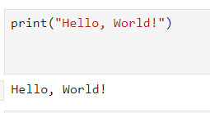
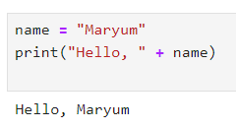
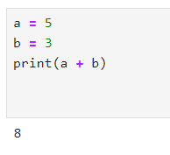
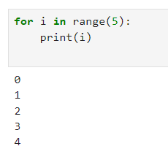
Basic Python Programs
Example 3
Example 1
Example 4
Example 2

Slide 15
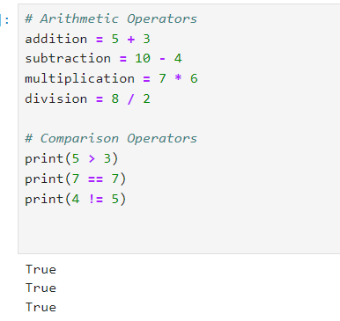
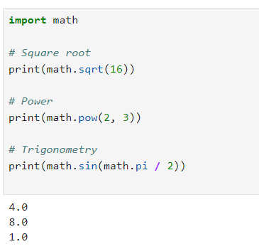
Example 5
Example 6
$100 M

Slide 16
Ai Terminologies
Artificial Intelligence (AI): The simulation of human intelligence processes by machines.
Machine Learning (ML): A subset of AI that involves the use of algorithms
and statistical models to perform tasks without explicit instructions.
Deep Learning: A subset of ML involving neural networks with many layers.
Neural Networks: Computing systems inspired by the biological neural networks that constitute animal brains.
Natural Language Processing (NLP): A field of AI focused on the interaction between computers
and humans through natural language.

Slide 17
Brief History of AI
1950s: Birth of AI with Alan Turing's question "Can machines think?"
and the development of the Turing Test.
1956: Dartmouth Conference where the term "Artificial Intelligence" was coined.
1970s-1980s: AI Winters due to reduced funding and interest.
1997: IBM's Deep Blue defeats world chess champion Garry Kasparov.
2010s-Present: Advancements in machine learning, deep learning,
and AI applications like self-driving cars and virtual assistants.

Slide 18
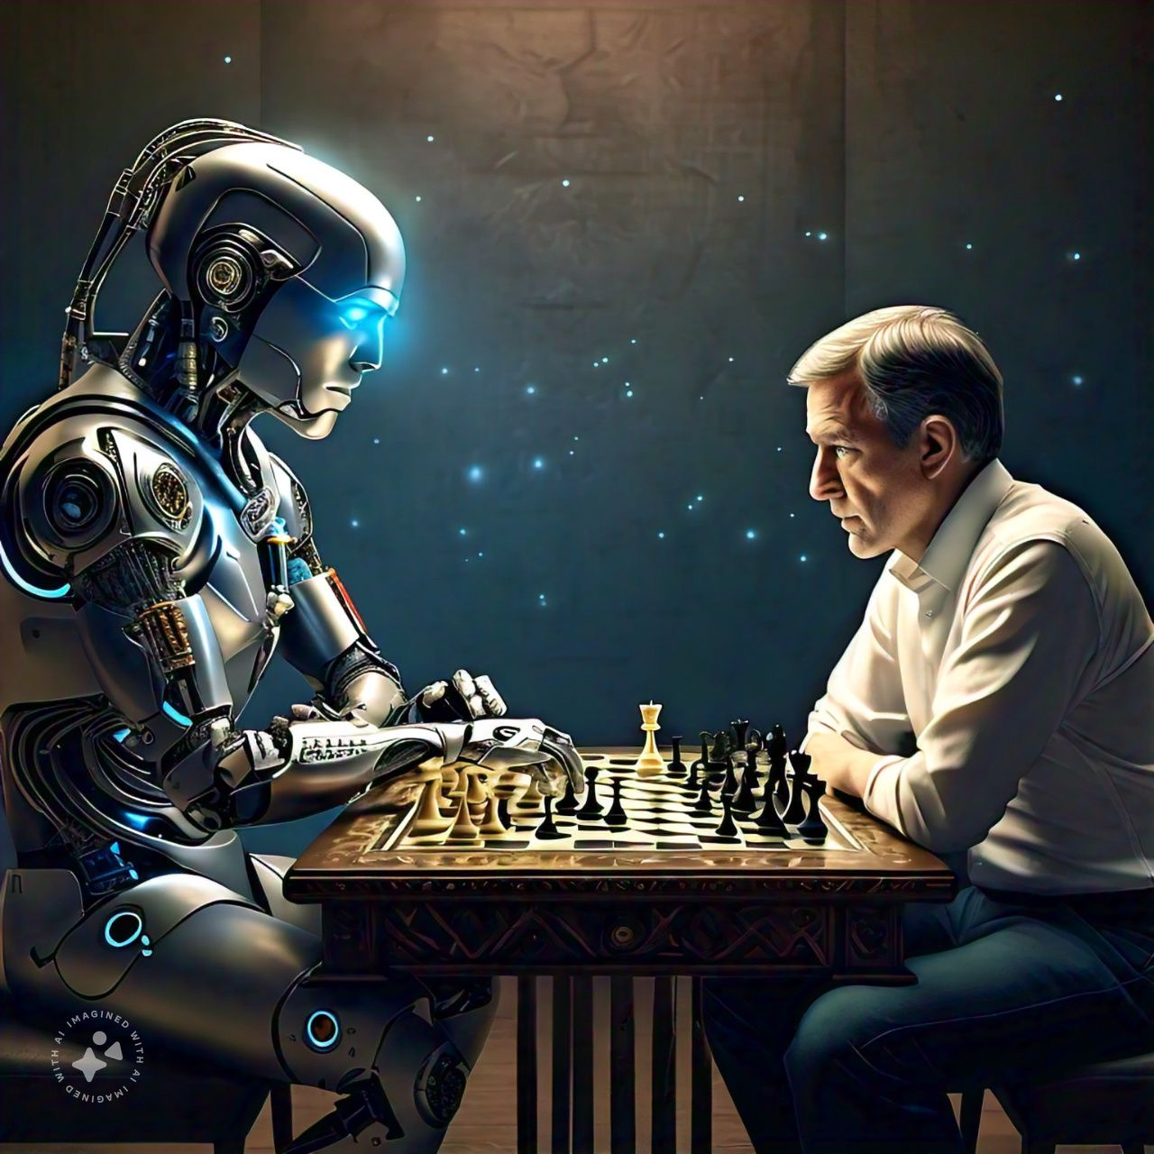
Brief explanation on Centaur Chess
Deep Blue was a chess computer developed by IBM. It is famous for defeating the chess world champion, GM Garry Kasparov, in
their 1997 match. Deep Blue's victory was viewed as a symbolic testament to the rise of artificial intelligence—a victory for machine versus man.

Slide 19
Brief explanation on Centaur Chess
5.Error Reduction: Computers help in checking for errors and calculating complex positions.
6. High-Level Games: Often results in games with better-quality moves and fewer mistakes.
7. Human-Machine Collaboration: Demonstrates the potential for effective collaboration
between humans and machines in strategic tasks.
8.Exploration of Potential: Helps explore how human and machine strengths can complement
each other in problem-solving scenarios.

Slide 20
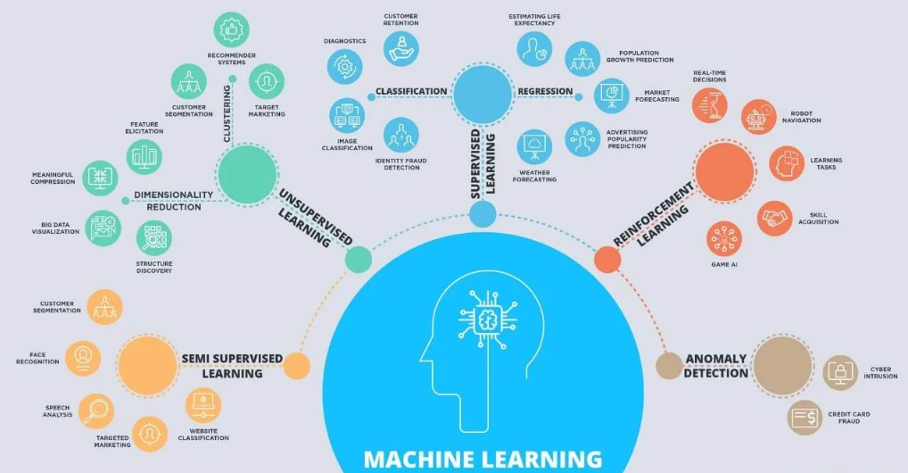
Machine learning
Definition of Machine Learning
Machine learning is a type of artificial intelligence where computers
learn from data to make decisions or predictions without being
explicitly programmed for each task.
Example of Machine Learning
1) Email Spam Filter
How It Works:
1. Training: The computer looks at many examples of emails labeled as "spam" or "not spam.“
2. Learning: It learns to recognize patterns, like certain words or phrases common in spam emails.
3. Prediction: When a new email arrives, the computer uses what it learned to decide if the email is spam or not.
Benefits:
- Automatic Sorting: Saves you from having to manually sort through your emails.
- Increased Efficiency: Helps ensure you only see important emails in your inbox.

Slide 21
Types of Machine learning
Supervised learning
Unsupervised learning
Semi-supervised learning
Reinforcement learning

Slide 22
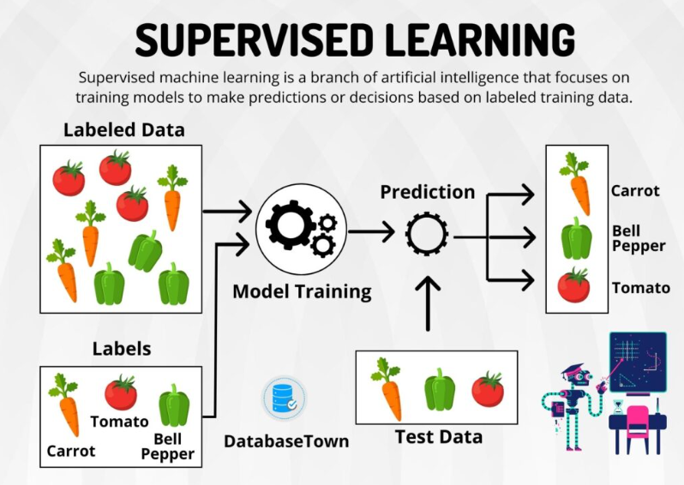
Supervised learning
Definition: A type of machine learning where the model is trained on labeled data, meaning each training example has an associated output label.
Common Algorithms:
Linear Regression: For predicting continuous values.
Logistic Regression: For binary classification tasks.
Decision Trees: For classification and regression tasks.
Support Vector Machines (SVM): For classification tasks.
K-Nearest Neighbors (KNN): For classification and regression tasks.
Neural Networks: For complex tasks involving large datasets.
Example:
Predicting House Prices: Using historical data of house features (size, location, number of rooms) and their corresponding prices to predict the price of a new house.

Slide 23
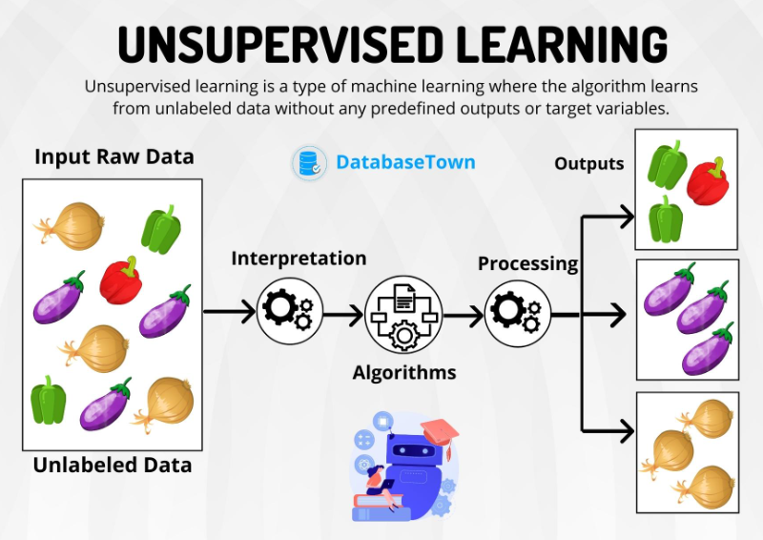
Unsupervised learning
Definition: A type of machine learning where the model is trained on unlabeled data and must find patterns or structures within the data.
Common Algorithms:
K-Means Clustering: For partitioning data into K distinct clusters.
Hierarchical Clustering: For building a hierarchy of clusters.
Principal Component Analysis (PCA): For dimensionality reduction.
Autoencoders: For learning efficient representations of the data.
Example:
Customer Segmentation: Grouping customers based on purchasing behavior to identify distinct segments for targeted marketing.

Slide 24
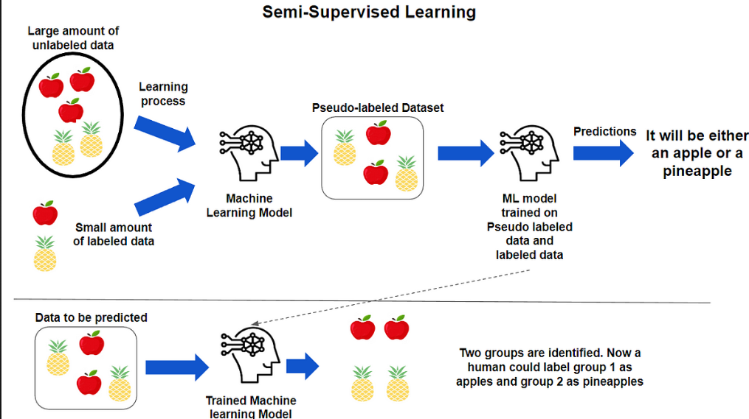
Semi-supervised learning
Definition: A type of machine learning that uses a combination of a small amount of labeled data and a large amount of unlabeled data.
Common Algorithms:
Semi-Supervised Support Vector Machines (S3VM): An extension of SVM for semi-supervised learning.
Label Propagation: Spreading labels from labeled to unlabeled data points.
Co-Training: Training multiple classifiers on different views of the data.
Example:
Speech Recognition: Using a small set of transcribed audio files along with a larger set of untranscribed audio files to improve the accuracy of speech recognition models.

Slide 25
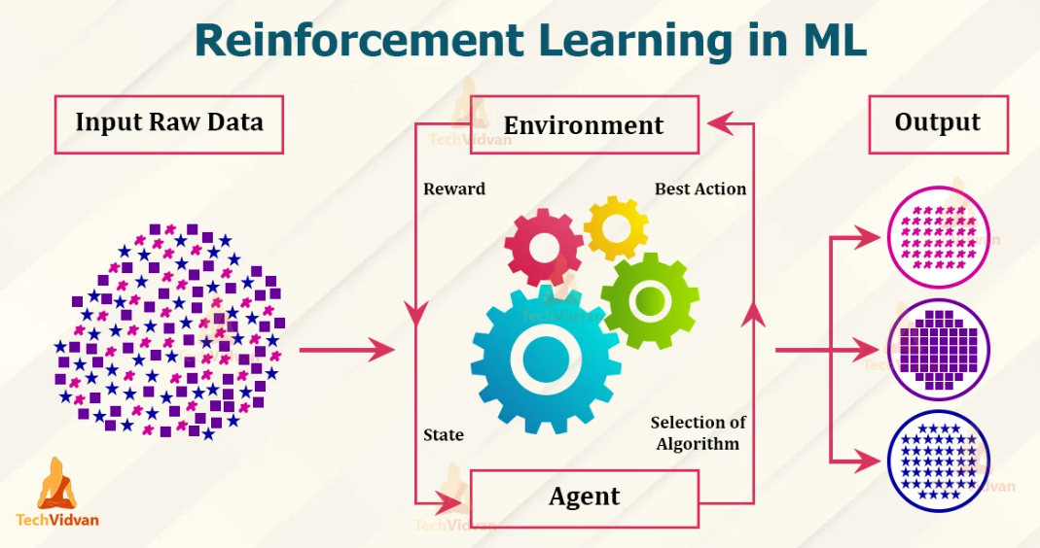
Reinforcement learning
Definition: A type of machine learning where an agent learns to make decisions by taking actions in an environment to maximize cumulative rewards.
Common Algorithms:
Q-Learning: A model-free reinforcement learning algorithm.
Deep Q-Networks (DQN): Using deep learning to approximate the Q-values.
Policy Gradient Methods: For directly optimizing the policy.
Proximal Policy Optimization (PPO): A robust policy gradient method.
Example:
Training a Robot: Teaching a robot to navigate a maze by rewarding it for reaching the goal and penalizing it for hitting walls.

Slide 26
Deep learning
Definition
Deep Learning: It is a subset of machine learning where artificial neural networks, inspired by the structure and function of the human brain, learn from large amounts of data to perform tasks that traditional algorithms struggle with. It involves multiple layers of abstraction to automatically learn representations of data.
Example
Image Recognition: Using deep learning, specifically convolutional neural networks (CNNs), to classify objects in images. For instance, a deep learning model can distinguish between different types of animals in photographs with high accuracy.

Slide 27
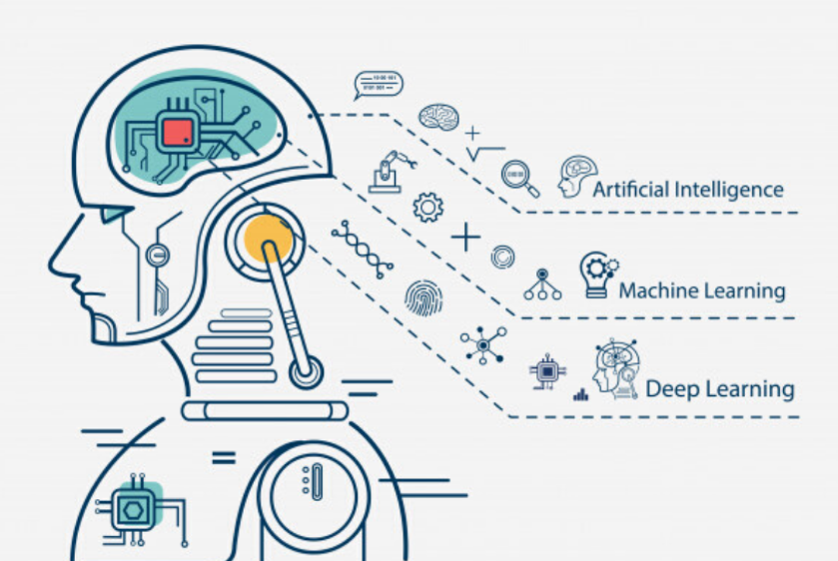
Deep learning
Algorithm
Convolutional Neural Networks (CNN)
- Definition: CNNs are specialized deep learning architectures designed to process data that has a grid-like topology, such as images or sound waves. They use convolutional layers to automatically learn hierarchical representations of the input data.
- Example: In image recognition, a CNN consists of convolutional layers that apply filters across the input image to extract features like edges and textures. These features are then passed through pooling layers to reduce dimensionality before being fed into fully connected layers for classification.

Slide 28
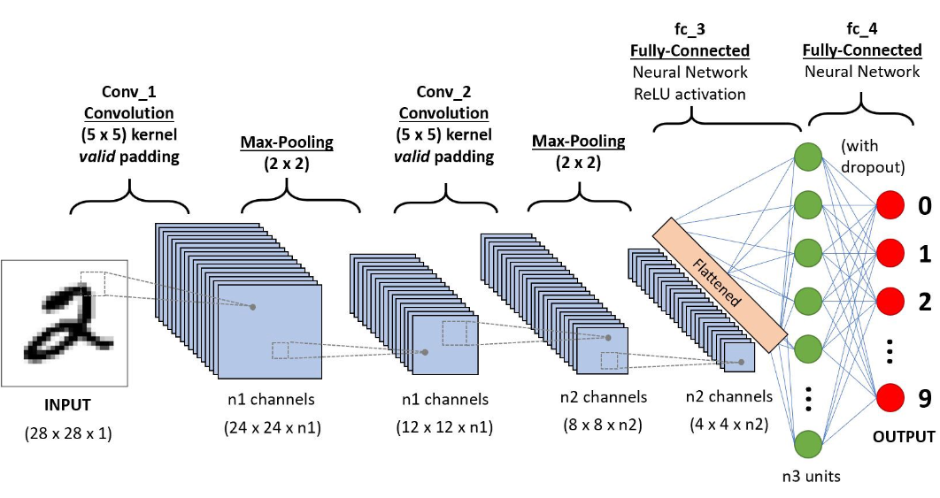
1. Convolutional Neural Networks (CNNs)
Definition: CNNs are deep learning algorithms designed specifically for processing structured grid data,
such as images. They are particularly effective for tasks like image recognition and classification.
Algorithm Example:-
- Input Layer: Receives image input.
- Convolutional Layer: Applies convolution operations using filters to detect features.
- Pooling Layer: Reduces dimensionality and computational load by down-sampling.
- Fully Connected Layer: Connects neurons between layers to combine features.
- Output Layer: Provides classification results.
Example: Image classification for recognizing handwritten digits (MNIST dataset).

Slide 29
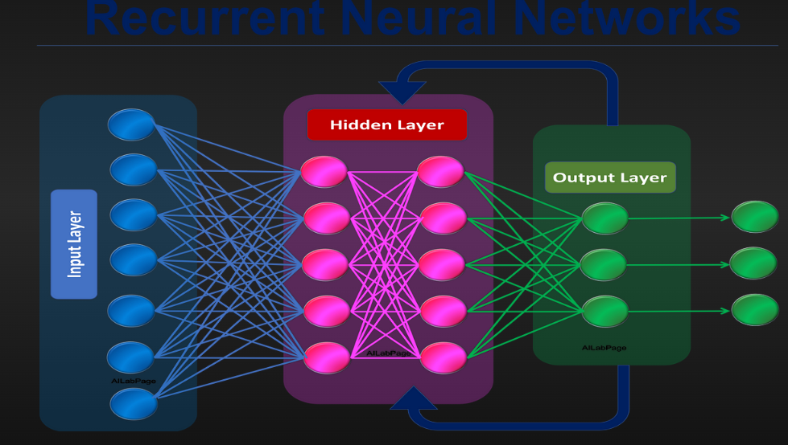
2. Recurrent Neural Networks (RNNs)
Definition: RNNs are designed to handle sequential data by maintaining a memory of previous inputs,
making them suitable for tasks like language modeling and time series prediction.
Algorithm Example:
Input Layer: Receives sequential input data.
Recurrent Layer: Uses hidden states to remember previous inputs.
- Output Layer: Produces the final output for the sequence.
Example: Predicting the next word in a sentence.

Slide 30
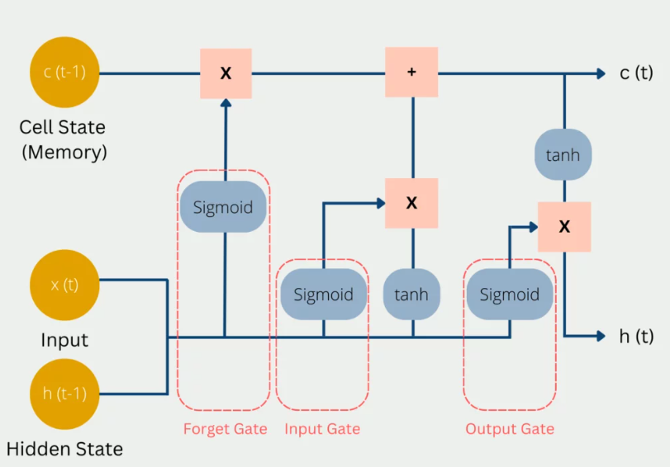
3. Long Short-Term Memory Networks (LSTMs)
Definition: LSTMs are a type of RNN designed to overcome the vanishing gradient problem, making them effective for long-term dependencies in sequences.
Algorithm Example:
Input Layer: Receives sequential input data.
LSTM Layer: Maintains cell states and hidden states to remember long-term dependencies.
- Output Layer: Produces the final output for the sequence.
Example: Speech recognition.

Slide 31
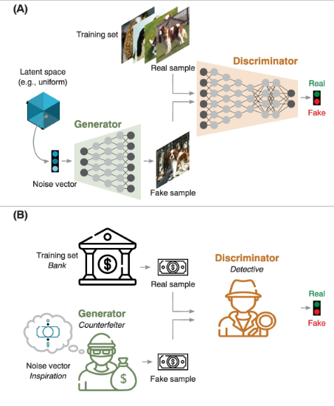
4. Generative Adversarial Networks (GANs)
Definition: GANs consist of two neural networks, a generator and a discriminator, that compete with each other to produce realistic synthetic data.
Algorithm Example:
Generator: Creates synthetic data.
Discriminator: Evaluates the authenticity of the data (real or fake).
- Training: The generator improves to produce more realistic data as the discriminator gets better at detecting fakes.
Example: Creating realistic images from noise.

Slide 32
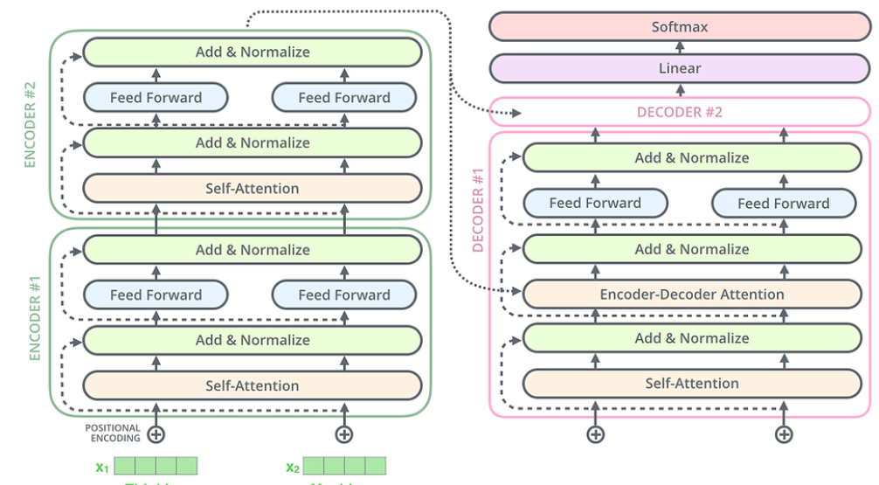
5. Transformer Networks
Definition: Transformer networks use self-attention mechanisms to process sequential data without relying on recurrence, making them efficient for tasks like natural language processing (NLP).
Algorithm Example:
Input Layer: Tokenizes and embeds input data.
Attention Mechanism: Calculates attention scores to weigh the importance of different parts of the input.
Feed-Forward Layer: Applies a fully connected layer to process the attention output.
- Output Layer: Generates the final output.
Example: Machine translation.

Slide 33
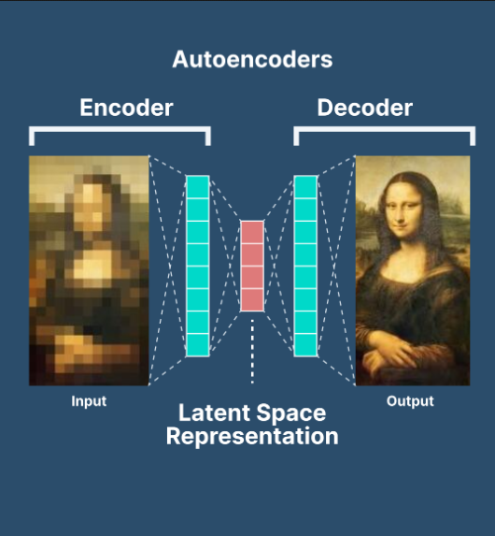
6. Autoencoders
Definition: Autoencoders are unsupervised learning algorithms that learn to compress and reconstruct data, useful for tasks like anomaly detection and data denoising.
Algorithm Example:
Encoder: Compresses input data into a latent space representation.
Decoder: Reconstructs the original data from the latent representation.
- Training: Minimizes the difference between the input and reconstructed data.
Example: Image denoising.

Slide 34
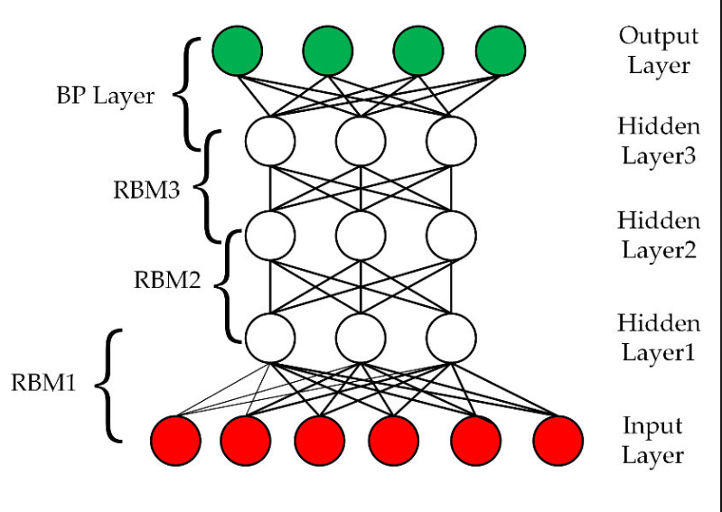
7. Deep Belief Networks (DBNs)
Definition: DBNs are generative graphical models composed of multiple layers of hidden units, where each layer learns to represent the input data distribution.
Algorithm Example:
Layer-Wise Training:Trains each layer as a Restricted Boltzmann Machine (RBM).
Fine-Tuning: Uses backpropagation to fine-tune the entire network.
- Output Layer: Provides the final output based on learned representations.
Example: Image classification.

Slide 35
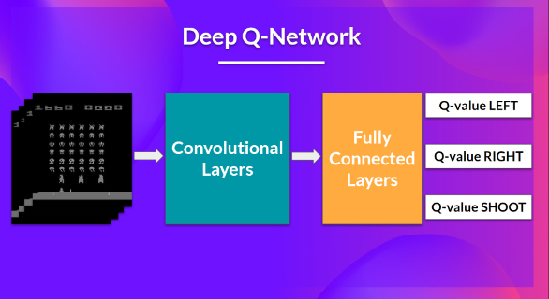
8. Deep Q-Networks (DQNs)
Definition: DQNs are reinforcement learning algorithms that use deep neural networks to approximate the Q-value function, enabling agents to learn optimal actions in complex environments.
Algorithm Example:
Input Layer: Receives state information.
Q-Network: Predicts Q-values for each action.
Action Selection: Chooses actions based on predicted Q-values.
- Training: Updates the Q-network using experience replay and Q-learning updates.
Example: Playing video games.

Slide 36
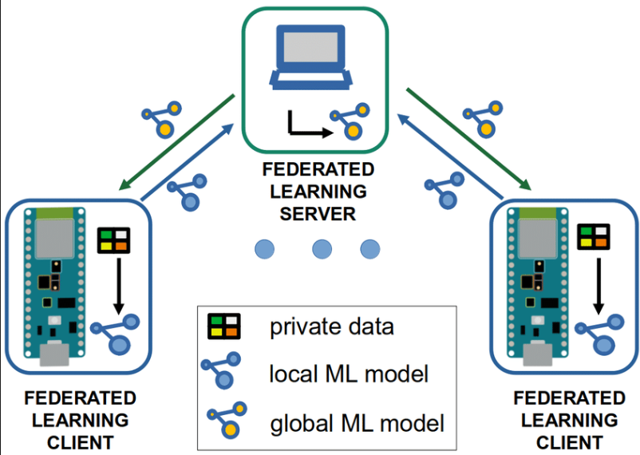
Federated Learning
Definition:
Federated Learning is a decentralized machine learning
approach where multiple devices
collaboratively train a model while keeping their data local.
This technique improves privacy and security by ensuring
that raw data never leaves the local devices.
Algorithm Example:
Initialization: A global model is initialized on a central
server.
2. Local Training: Each participating device downloads the current global model and trains it locally on its own data.
3. Update Aggregation: Each device sends only the model updates (gradients) back to the central server, without sharing the raw data.
4. Model Aggregation: The central server aggregates the updates from all devices to update the global model.
5. Iteration: Steps 2-4 are repeated until the model converges.
Example: Predictive text on smartphones, where the model learns from the typing behavior of users without accessing their actual messages.

Slide 37
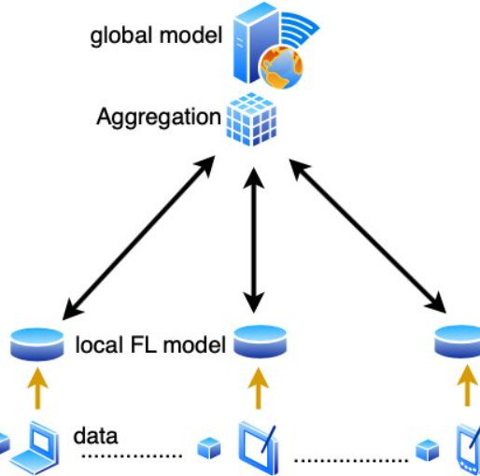
Federated Averaging (FedAvg)
- Definition: An algorithm used in federated learning to average the
model updates from multiple devices.
- Algorithm Example:
1. Each device computes the gradient updates based on its
local data.
2. The server collects and averages these gradients.
3. The averaged gradients are used to update the global model.
Example: In a federated learning system for healthcare, each hospital
computes model updates based on its patient data, and these updates
are averaged to improve a global predictive model.

Slide 38
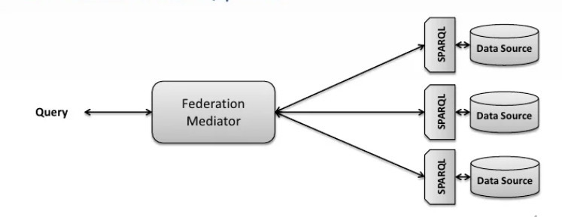
2. Federated Optimization
- Definition: Optimization techniques tailored for federated learning to handle
issues like data heterogeneity and communication efficiency.
- Algorithm Example: Adaptations of traditional optimization algorithms (e.g., SGD, Adam)
to the federated setting, ensuring robustness against data disparities among devices.
Example: Using an adapted SGD algorithm to optimize a global model for personalized
fitness tracking apps, considering the diverse activity patterns of users.

Slide 39
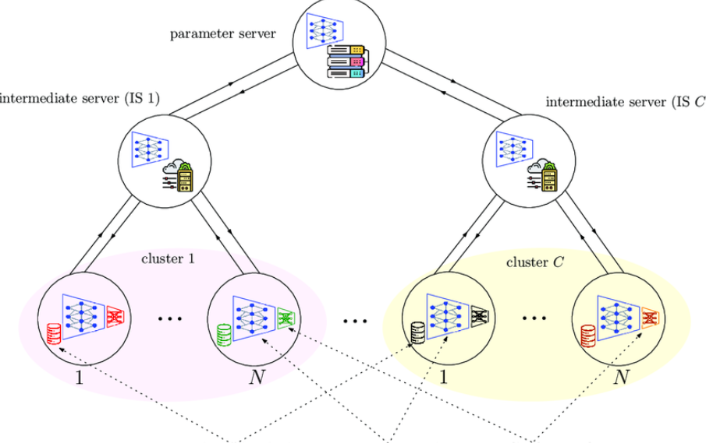
3. Personalized Federated Learning
- Definition: Techniques that allow each device to have a personalized model, which is fine-tuned from the global model to better suit local data.
- Algorithm Example: After global training rounds, each device performs additional local training on the global model to create a personalized version.
Example: Personalized recommendations in a news app where the global model is personalized based on individual reading habits.

Slide 40
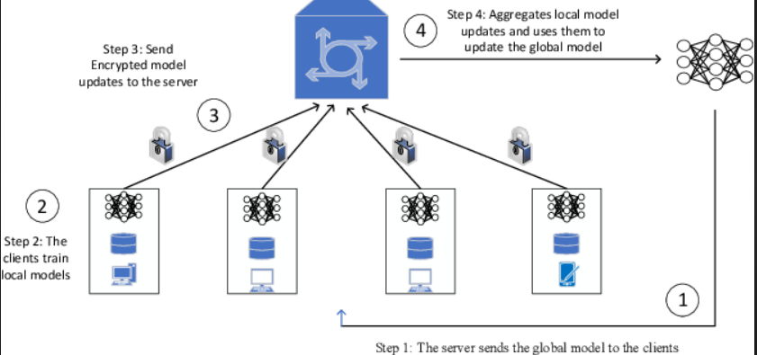
4. Secure Aggregation
- Definition: Methods to securely aggregate model updates from multiple devices without revealing individual updates.
- Algorithm Example:
1. Devices encrypt their updates before sending them to the server.
2. The server aggregates the encrypted updates and then decrypts the aggregated result.
Example: Ensuring privacy in a federated learning system for financial institutions, where individual model updates are encrypted to prevent data leakage.

Slide 41
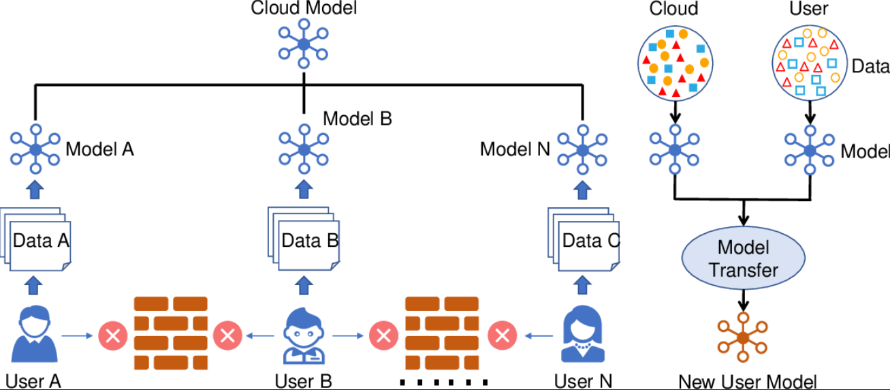
5. Federated Transfer Learning
- Definition: Combining federated learning with transfer learning to leverage knowledge from related tasks or domains.
- Algorithm Example: Pre-trained models from related tasks are used as a starting point for federated learning, improving convergence and performance.
Example: Using a pre-trained language model to quickly adapt to specific jargon and terminology in a federated learning system for legal document analysis.

Slide 42
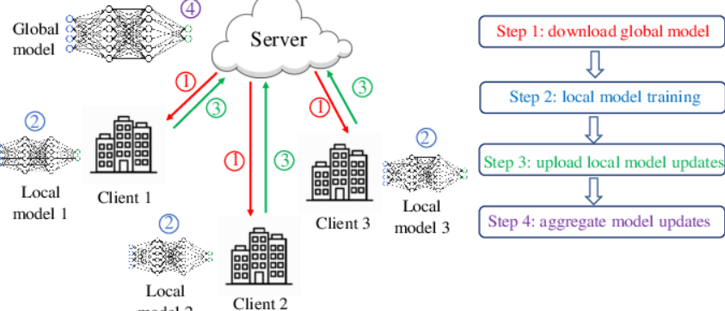
6. Cross-Silo Federated Learning
- Definition: Federated learning involving a small number of reliable and powerful nodes, typically institutions or organizations.
- Algorithm Example: Each institution trains a local model on its data, and the updates are aggregated centrally.
Example: Collaborative research among hospitals to develop a shared diagnostic model for rare diseases.

Slide 43
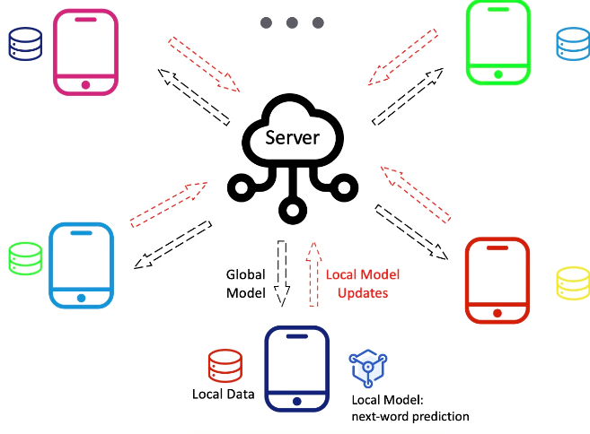
7. Cross-Device Federated Learning
- Definition: Federated learning involving a large number of unreliable and resource-constrained devices like smartphones.
- Algorithm Example: Devices with intermittent connectivity and varying availability contribute to the global model when they are available.
Example: A global predictive text model trained across millions of smartphones.

Slide 44
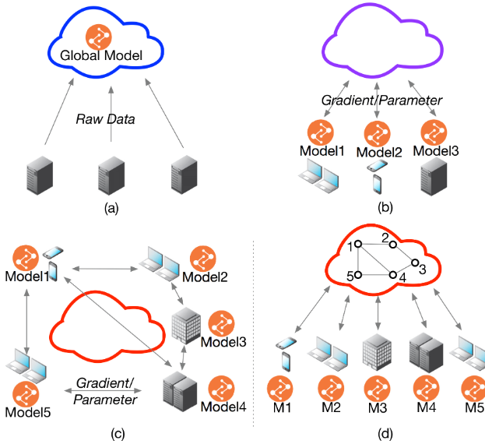
8. Federated Multi-Task Learning
Definition: A federated learning approach where multiple related tasks are learned simultaneously, allowing the sharing of knowledge across tasks.
- Algorithm Example: Each device learns a model for its specific task while sharing common parameters with other devices to improve overall performance.
Example:Learning personalized models for different users' preferences in a music recommendation system, where some parameters are shared globally.

Slide 45
Thanks!
Contact Information: www.linkedin.com/in/maryum756
Please keep this slide for attribution

